Slide 1
St. Mac Dara’s Community College
Leaving Certificate
Subject Choice

Slide 3
Leaving Certificate Programme
Leaving Certificate is a 2 year programme.
7 subjects are taken for the Leaving Certificate.
Subject Levels
Higher and Ordinary level → all subjects.
Foundation level →Mathematics & Irish.
LC subject selection
Core subjects: English, Mathematics & Irish*
Optional subjects: 4 other subjects

Slide 4
Optional Subjects-Choose Four
BUSINESS
Business
Accountancy
Economics
SCIENCE
Biology
Physics
Chemistry
LANGUAGES
French
German
Italian
Spanish
APPLIED SCIENCES
Home Economics
Construction Studies
Design and Communication Graphics
Engineering
SOCIAL STUDIES
History
Geography
Music
Art
Physical Education
Information about LC subjects can be found on the NCCA website: www.ncca.ie

Slide 5
Sample Requirements
Irish
Primary Teaching
Maths
Engineering
Computer science
Actuarial studies
Physics
Science Subjects
Nursing
Engineering
Science
Computer science
Medicine
Dentistry
Pharmacy
Veterinary
A Third Language
Many courses require a third language
Required for some faculties at UCD, MU, NUIG,UCC
eg. Law, Commerce, Arts
Generally required to study a Language at Third Level
Exceptions are Science, Engineering and Nursing do not require a language
NCAD can select ART instead of a language
A language is not required for TCD, DCU, UL or any Institute of Technology unless a language option within the course

Slide 6
Specific Course Requirements
Course Entry Requirements can be accessed:
College prospectuses
College websites
Directory of LC Entry Requirements
Guidelines for Subject Choice booklet
Career’s websites

Slide 7
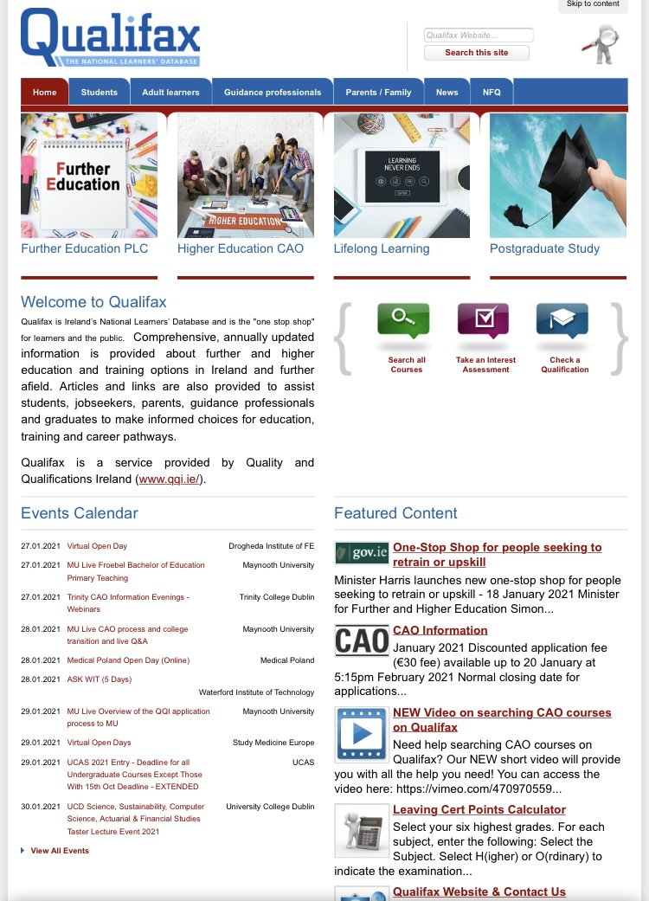
CHECK MINIMUM SUBJECT REQUIREMENTS ONLINE…

Slide 9
General Advice
If a student is not really sure what he/she wants to do in the future:
Pick a broad range of subjects in order to keep options open
Many students will change their minds about their future a number of times in the next 2 years
E.g.
one language
one science
one business
one humanities / applied science.
This combination would allow access into a broad range of courses/careers.

Slide 10
Choosing a Subject
A wise choice of subjects requires:
RESEARCH
DISCUSSION
REFLECTION
DECISION
Subject Teachers, Guidance Classes, TY Programme
L.C. Books, Publications, Other Students
Guidance Counsellors, Current Teachers
Family, Friends
Consider all the information, views and opinions
Then, ultimately each student must make up their own mind.

Slide 12
Useful Websites
Internet
Qualifax – www.qualifax.ie Irish courses database
CAO – www.cao.ie Contains links to course websites
Careersportal.ie- www.careersportal.ie
College websites
www.tcd.ie
www.ucd.ie
www.dit.ie
www.ncca.ie

