Slide 1
Deciding What subjects to choose
Where Caution is required

Slide 2
Leaving Cert
 | Higher Level | Ordinary Level | Foundation Level
English | X | X
Irish | X | X | X
Maths | X | X | X
Language | X | X
Choice A | X | X
Choice B | X | X
Choice C | X | X

Slide 3
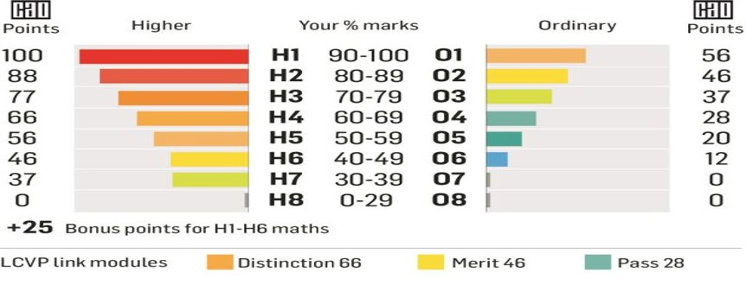

Slide 4
What are the Requirements in LC for various Options
Apprenticeship = min 5 passes
PLC = Min 5 Passes
Need to choose subjects that will
get you these minimum requirements

Slide 5
University/College
University Level 8 degree: UCD, TCD, TUD, DCU, Maynooth
Minimum entry:
2H5 + 4H7/O6
NUI = Irish* and often a 3rd language
Course may have Level or subject requirements
Points (max 625)
Need to choose subjects that will Maximise
your points

Slide 6
Best Advise re: Subject Choice
Subject you like
Subject you are best at
Subject you will work harder at
Get a better Grade in the LC

Slide 7
Subject Level/Grade Requirements
Primary School Teaching = Min H4 in Irish
Engineering/Science/ Data/ Computer/ Healthcare/Finance = Min H4 in Maths

Slide 8
Subject Requirements
Science Subjects (Level 8)
All Healthcare Courses – a couple need 2 Science Subjects
All Science Courses
A lot of Sports courses
A lot of Engineering Courses
Chemistry = required for 6 courses – Vet, Dietetics, some pharmacy, medical and dental.

Slide 9
Language Requirement
Majority of Courses in TUs, TCD and DCU don’t need a FL
NUI – UCD (65% of courses you need a third language)*
Maynooth (55% of courses you need a third language)*
*Including Arts Degrees
However, only need O6/H7 to meet minumum requirements. Don’t need to count as one of 6 points subjects.

Slide 10
How we are helping students with this choice
Meet all one-to-one
Explore favourite subjects, career area aspirations etc
Look at grades in past subjects
Look at strengths from past aptitude tests
Take into account any challenges a student may have
Go through each of the subjects in class – subject choice booklet
Current 5th years invited to 3rd year class to talk about their subject – why they chose it, if it is what they thought, projects etc

Slide 11
Process
Students going into 5th year in September 2023 will be given a form and asked to choose the subjects they wish to study for LC ranked 1-6
This is all put into the computer and the computer aligns timetables, teachers, rooms etc
Produces a timetable that gives most people their top 4 choices
Timelines:

